Slide 1
Abstract interpretation for the working programmer Lezione 2 – Domini Astratti
Francesco Logozzo
Microsoft Research
Redmond, WA, USA

Slide 2



Clousot: Analysis structure
Expression analysis
Heap analysis
Stack analysis
Analyses
Bounds, nonnull, arrays…
Source: z = x + y
From here

Slide 3
Compilation
In general loses information
The program is decomposed in smaller chunks
The static analysis should recover it
Loops are no more explicit
No if statements
No explicit guards
No Boolean connectives
…

Slide 4
Wanted:(Relative) completeness
P
⟦P⟧
⊑
C(P)
⟦C(P)⟧
Consequences:
No imprecision introduced by the compilation
Bytecode analysis as precise as the source one
It can be more precise
It relates abstract semantics
The abstract semantics for the source can be incomplete w.r.t. concrete
Is it always the case??

Slide 5
Exercise
Suppose x ∈ [0,1]
public double DivCompiled(double x)
{
double t1 = 1 + x;
double t2 = x / t1;
return t2;
}
public double Div(double x)
{
return x / (1 + x);
}
Which is the interval for the value returned by the two methods?

Slide 6
Where is the problem?
Lost the relation between the two x
But they are the same variable!
Compilation put the program in normal form
Advantages:
Type checking, name resolution, fewer cases
Disadvantages:
Smaller window on the program
Solution?
Rebuild the expressions

Slide 7
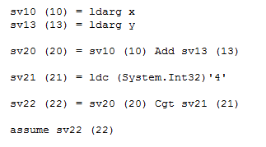
Example
At high level: x + y ≤ 4
Compiled:
(and de-stack, de-heap, …)

Slide 8
Brainstorm: How to recover info?

Slide 9
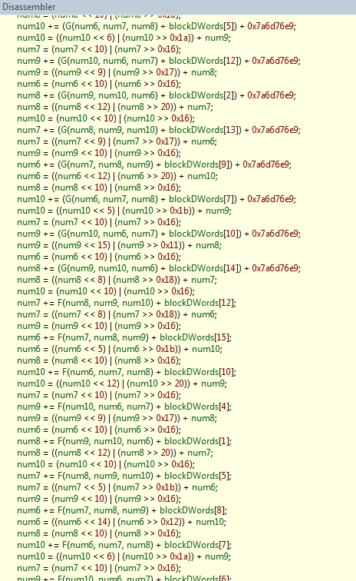
Eager expression reconstruction?
MDTransform
9000 straight line instructions

Slide 10
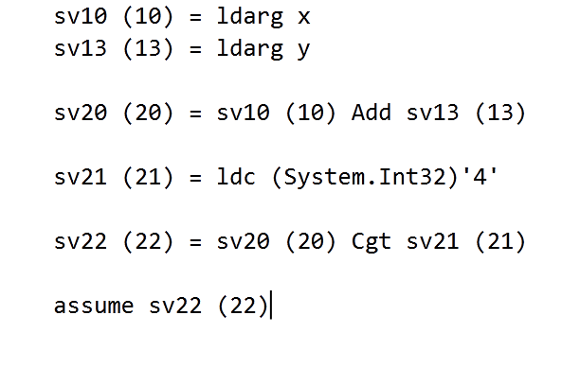
Lazy expression recovery

Slide 11
Essentially a domain refinement
Given
Abstract domains 〈 D+, ⊑+ 〉 ←γ ← 〈 D, ⊑ 〉
Abstract semantics
ℍ⟦⋅⟧ ∈ D → D , 𝕃⟦⋅⟧ ∈ D+ → D+
(… some more hypotheses …)
∀ d ∈ D:
P
γ(ℍ ⟦P⟧(d))
⊑
C(P)
π (𝕃 ⟦C(P)⟧(γ(d)))

Slide 12
Non-Null analysis

Slide 13
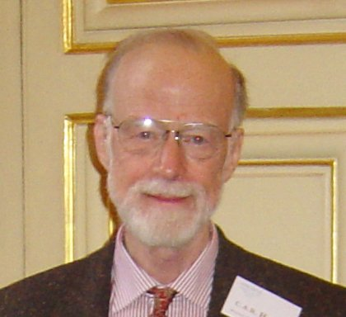
“Null references: The billion dollar mistake”
“I call it my billion-dollar mistake.
It was the invention of the null reference in 1965.
At that time, I was designing the first comprehensive type system for references in an object oriented language (ALGOL W). My goal was to ensure that all use of references should be absolutely safe, with checking performed automatically by the compiler.
But I couldn't resist the temptation to put in a null reference, simply because it was so easy to implement. This has led to innumerable errors, vulnerabilities, and system crashes, which have probably caused a billion dollars of pain and damage in the last forty years.”

Slide 14
Example
public string TrimSuffix(string s, string suffix)
{
Contract.Requires(s != null);
Contract.Requires(suffix != null);
string res = s;
while (res.EndsWith(suffix))
{
int len = res.Length - suffix.Length;
res = res.Substring(0, len);
}
Contract.Assert(res != null);
return res;
}

Slide 15
Analysis steps (recall)
Read the bytecode
Program transformations
De-Stack
CFG Construction
De-heap
Expression recovery
Collect proof obligations
Analysis
Check
…

Slide 16
With proof obligations explicit
public string TrimSuffixWPO(string s, string suffix)
{
Contract.Requires(s != null);
Contract.Requires(suffix != null);
string res = s;
Contract.Assert(res != null);
while (res.EndsWith(suffix))
{
Contract.Assert(res != null);
Contract.Assert(suffix != null);
int len = res.Length - suffix.Length;
Contract.Assert(res != null);
res = res.Substring(0, len);
Contract.Assume(res != null); // Postcondition of res
}
Contract.Assert(res != null);
return res;
}

Slide 17
Analysis steps (recall)
Read the bytecode
Program transformations
De-Stack
CFG Construction
De-heap
Expression recovery
Collect proof obligations
Analysis
Check
…

Slide 18
Abstract domain for the analysis
⊤
Null
NotNull
⊥
Point-wise extension for environments
Point-wise?
Simple and finite domain
Fast convergence

Slide 19
Assume & Assert
During the analysis assert are turned into assume
Why?
If an assert does not hold, the program crashes
If we reach the point after the assert, then it holds
So we can trust it holds
(we delay the check to the next phase)

Slide 20
Analysis
public string TrimSuffixWPO(string s, string suffix)
{
Contract.Requires(s != null);
Contract.Requires(suffix != null);
string res = s;
Contract.Assume(res != null);
while (res.EndsWith(suffix))
{
Contract.Assume(res != null);
Contract.Assume(suffix != null);
int len = res.Length - suffix.Length;
Contract.Assume(res != null);
res = res.Substring(0, len);
Contract.Assume(res != null); // Postcondition of res
}
Contract.Assume(res != null);
return res;
}
s, suffix, res: NotNull
s, suffix, res: NotNull
s, suffix : NotNull, res: ⊤
s, suffix, res: NotNull

Slide 21
Checking
public string TrimSuffixWPO(string s, string suffix)
{
Contract.Requires(s != null);
Contract.Requires(suffix != null);
string res = s;
Contract.Assert(res != null);
while (res.EndsWith(suffix))
{
Contract.Assert(res != null);
Contract.Asert(suffix != null);
int len = res.Length - suffix.Length;
Contract.Assert(res != null);
res = res.Substring(0, len);
Contract.Assume(res != null); // Postcondition of res
}
Contract.Assert(res != null);
return res;
}
s, suffix: NotNull, res : Null
s, suffix, res: NotNull
s, suffix, res: NotNull
s, suffix : NotNull, res: ⊤
s, suffix, res: NotNull
Ok!

Slide 22
What we did?
We over-approximated the semantics
We kept the concrete specification
Specification
Program

Slide 23
Limits?
No relations
Can say
“a variable is null/is not null”
Cannot say
“a variable is null if another var is not null”

Slide 24
Numerical Analysis

Slide 25
GCD
static public int GCD(int x, int y)
{
Contract.Requires(x > 0);
Contract.Requires(y > 0);
Contract.Ensures(Contract.Result<int>() > 0);
while (true)
{
if (x < y)
{
y %= x;
if (y == 0)
return x;
}
else
{
x %= y;
if (x == 0)
return y;
}
}
}
We need numerical reasoning

Slide 26
Intervals
Approximate each variable with a range
[a, b] where a, b ∈ Z ∪ { +∞, -∞ }
More complex in reality because of
Overflows
Different Int types (16, 32, 64 bits, signed/unsigned)
Order: interval inclusion
Join: interval union
Meet: interval intersection
Widening: ?

Slide 27
Example
static public int GCD(int x, int y)
{
Contract.Requires(x > 0);
Contract.Requires(y > 0);
Contract.Ensures(Contract.Result<int>() > 0);
while (true)
{
if (x < y)
{
y %= x;
if (y == 0)
return x;
}
else
{
x %= y;
if (x == 0)
return y;
}
}
}
x :[1,+∞] y :[1,+∞]
x :[1,+∞] y :[1,+∞]
Loop invariant!
x :[1,+∞], y:[2, +∞]
x :[1,+∞], y:[0, +∞]
x :[1,+∞], y:[1, +∞]
x :[1,+∞], y:[1, +∞]
Ok!
x :[0,+∞], y:[1, +∞]
x :[1,+∞], y:[1, +∞]

Slide 28
Exercise (home?)
Does the GCD terminate?
How can we leverage intervals to prove it?

Slide 29
Bounds checking example
public void AllToZero(int[] a)
{
for (int i = 0; i < a.Length; i++)
{
Contract.Assert(i >= 0);
Contract.Assert(i < a.Length);
a[i] = 0;
}
}
a.Length :[0. +∞] i :[0,+∞]
Not Ok!

Slide 30
What are we missing?
Intervals keep only numerical information
No symbolic information
Ex. i < a.Length
No relations
Intervals are an example of a non-relational domain
Non-null is non-relational too

Slide 31
Relational numerical abstract domains

Slide 32
Abstract domains
0 ≤ index < array.Length?
Intervals
O(n)
a ≤ x ≤ b
No ☹
Pentagons
O(n)
a≤ x ≤ b & x <y
Yes ☺
Octagons
O(n³)
± x ± y ≤ a
Yes ☺
Polyhedra
O(2^{n})
Σ a_{i}x_{i} ≤ b
Yes ☺

Slide 33
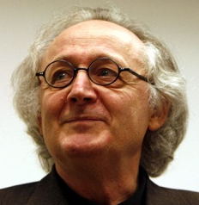

Polyhedra
Discover invariants in the form of
x variables, a, b constants
Dual representation for elements
Set of inequalities
Set of points and generators
Some operations better in one some in the other
Meet: Intersection of equations
Join: Convex hull of points

Slide 34
Everything done in the 70s?
Conversion is expensive ☹
Constraints → Generators is exponential (worst case)
It cannot be done better:
Khachiyan, Boros, Borys, Elbassioni, Gurvich (2006): Generating all vertices of a polyhedron is hard
In practice scales to few variables:
~30 variables for the Parma Polyhedra Library
Very optimized C++ implementation
Up to date algorithms

Slide 35

Octagons
Discover invariants in the form of
x, y are variables
a ∈ {+1, -1, 0}
b is a constant
Elements are represented by a
direct graph: x – y ≤ b is
Efficient representation with sparse matrixes
Order, join, meet, … are defined point-wise

Slide 36
Closure
Inference rule
Propagated by Floyd-Marshall algorithm
Used everywhere
Constraint propagation is expensive ☹
“Bad” cubic algorithm
The multiplicative constant is 30
Constants are quickly propagated
Matrixes tends to be saturated
Many relations between unrelated variables

Slide 37
Pentagons: Main ideas
Intervals are efficient ☺
Compact representation of elements
Linear time operations
Intervals are good for numerical computations ☺
Pentagons: Refine Intervals with symbolic reasoning
In particular: strict upper bounds

Slide 38


Pentagons
Capture properties in the form of
x, y variables
a, b constants
Elements are pairs of maps
(Var → Intv) x (Var → ℘(Var))
Information is propagated
“reduction”

Slide 39
LessThan domain
Elements:
Var → ℘ (Var)
Efficient representation with hash tables
Order
“The less constraints the less the information”
A ⊑ B iff ∀ x ∈ B. B(x) ⊆ A(x)
Bottom
A such that ∃ x, y. y ∈ A(x) ∧ x ∈ A(y)
Checking it may require a transitive closure
Top
λx. ∅

Slide 40
LessThan domain
Join
A ⊔ B = λx. A(x) ∩ B(x)
Meet
A ⊓ B = λx. A ∪ B
Widening
Lattice has finite height ⇒ Join suffices
Transfer functions:
⟦ y := x - 1 ⟧(A) = (π_{y} A) [ y → { x } ∪ A(x) ]
⟦ y == x ⟧(A) = A[ x, y → A(x) ∪ A(y) ]
⟦ y < x ⟧(A) = A[ y → A(y) ∪ A(x) ∪ {x} ]

Slide 41
Pentagons
Reduced product of Intervals and LT
Not just pairs: information flows from one element to the other
(x → [1, 4], y → [3, 3], { x < y } ) ⇒ (x → [1, 2], y → [3, 3], {x < y} )
May introduce significant slowdown
For each (x, y) in Intv check if x < y and add to LT
For each x < y in LT, assume it in Intv
Reduction is applied
In precise points of the analysis
Ex. When checking assertions, on demand on transfer functions, …
Lazily at join points

Slide 42
Example: Cartesian join
Pair-wise Cartesian join is too imprecise
Lost all the information
Why? No propagation of information
(x →[0,0] ,y→[1,1], ∅)
(∅, { x < y })
⊔
(∅, ∅)

Slide 43
Join with reduction
Left_{P} = (left_{intv}, left_{lt})
Right_{P} = (right_{intv}, right_{lt})
⊔*
Join with reduction
Reduce Left_{P} and Right_{P}
Apply the join pair-wise
Brute force solution…

Slide 44
Example: Reduced Join ⊔*
Reduced Join is precise
Reduction on the left branch materializes the constraint x<y
Problem: Reduction introduces a quadratic slowdown
Even cubic if we saturate the LT part
(x →[0,0] ,y→[1,1], ∅)
(∅, { x < y })
(x →[0,0] ,y→[1,1], {x<y})
(∅, { x < y })
⊔*
(∅, {x < y})

Slide 45
The smarter join on Pentagons
Idea:
Apply the pair-wise join
If a symbolic constraint x < y is dropped, check if the other branch implies it
If it does, then keep the constraint
(x →[0,0] ,y→[1,1], ∅)
(∅, { x < y })
⊔
(∅, ∅)
(∅, {x < y})

Slide 46
⊔* and ⊔
(x →[0,0] ,y→[3,3], ∅)
(x→[-2,-2], y→[0,0], ∅)
⊔*
(x →[-2,0] ,y→[0,3], {x < y})
(x →[0,0] ,y→[3,3], ∅)
(x→[-2,-2], y→[0,0], ∅)
⊔
(x →[-2,0] ,y→[0,3], ∅ )

Slide 47
⊔* and ⊔
In theory :
⊔* is strictly more precise ⊔
In practice :
For mscorlib.dll we moved from > 1h to a couple of minutes
No access is lost!

Slide 48
Reminder & reduction
Reminder: u % d
Important for array accesses (e.g. hash)
Informal semantics
|u % d | < |d|
Hence, d ≥ 0 ⇒ u % d < d
In the analysis
Intervals alone do not infer useful bounds when d unbounded
LT alone do not infer lower bounds
Pentagons have the necessary information
Use Intervals to determine if d ≥ 0
Use LT to track the relation y < d

Slide 49
Are Pentagons enough?
Pentagons work well to discharge simple array obligations
Life is more complicated
Need to track
Inequalities
Relations between several variables
Non unary coefficients
…
So should we go back to Polyhedra?
Well, no

Slide 50
Life is more complex…
Proving simple properties complex reasoning
public void CopyTo(object[] from, object[] to, int start)
{
Contract.Requires(start >= 0);
Contract.Requires(start < to.Length);
Contract.Requires(from.Length <= to.Length - start);
for (int i = 0; i < from.Length; i++)
to[start + i] = from[i];
}
Cannot prove with Pentagons

Slide 51
Linear equalities
Discover relations in the form of
xi variables, ai and bi constants
Elements are sets of linear equations
Canonical representation as Upper matrixes
Order is space inclusion, Meet is intersection, …
Nice join algorithm (polynomial ☺)
Drawback: not really useful by their own
Few programs handle with equalities

Slide 52
Karr by example
public void Loop()
{
int x = 0, y = 2;
while (NonDet())
{
x++; y++;
}
Contract.Assert(y - x == 2);
}

Slide 53
Tree Domain
The higher in the hierarchy
The most precise the domain
The fewer variables it tracks
Domains reduction via message passing
Ex. Formalize it
B₁
B₂
B₃
B_{n-2}
B_{n-1}
B_{n}

Slide 54
Example
x < z ?
x < y ?
LinEq
y = z
x < y || x < t ?
LessEq
Intervals
t ≤ y
x == 2, t == 3
Ok! ☺

Slide 55
So far
We have seen several numerical domains
Intervals
Very fast, non-relational
Pentagons
Very fast, very weakly relational
Octagons
Fast, weakly relational
Tree domain
Combination of those above and more…
Linear equalities
Fast, only equalities

Slide 56
Still we need some more…
We need the expressive power of Polyhedra
Without giving up performance
void Append(int wb, int count)
{
Contract.Requires(wb >= 2 * count);
if (count + ChunkLen > ChunkChars.Length)
CopyChars(wb, ChunkChars.Length - ChunkLen);
}
private void CopyChars(int wb, int len)
{
Contract.Requires(wb >= 2 * len);
}
Cannot represent

Slide 57

Subpolyhedra
∑a_{i} x_{i} ≤ k ⇔ ∑a_{i} x_{i} = β ⋀ β ≤ k
Introduce a slack variable β
Reduced product of
Intervals
Scalable, fast…
Linear Equalities
Precise join, fast …
Challenge: Have a precise Join

Slide 58
Naif Join
assume x <= y
x = 0; y = 1
〈x - y == β, β ∈ [-∞, 0]〉
〈T, x ∈ [0,0] ⋀ y ∈ [1,1]〉
〈T, T〉
assert x <= y

Slide 59
Join algorithm : SubPolyhedra
Uniform slack variables
Reduce the states
Do the pair-wise join
Recover precision using deleted equalities
Recover precision using hints
Templates, 2D Convex Hull, Annotations …

Slide 60
Example : Join Step 1
Entry State:
s₀ : 〈x - y == β, β ∈ [-∞, 0]〉
s₁ : 〈T, x ∈ [0,0] ⋀ y ∈ [1,1]〉
Step 1 (uniform slack variables)
s’₀ : 〈x - y == β, β ∈ [-∞, 0]〉
s’₁ : 〈x - y == β, x ∈ [0,0] ⋀ y ∈ [1,1]〉

Slide 61
Example: Join steps 2-3
Step 2 (Reduction)
s’’₀ : 〈x - y == β, β ∈ [-∞, 0]〉
s’’₁ : 〈x - y == β, x ∈ [0,0] ⋀ y ∈ [1,1] ⋀ β ∈ [-1,-1]〉
Step 3 (Pair-wise join)
s₂ : 〈x - y == β, β ∈ [-∞, 0]〉

Slide 62
Example: Join Step 4
Recover lost relations
assume x == y
x = 0; y = 1
〈x - y == 0, T〉
〈T, x ∈ [0,0] ⋀ y ∈ [1,1]〉
〈T, T〉
〈x - y == β, β ∈ [-1, 0]〉
assert x<= y

Slide 63
Example : Join Step 5
assume y >= 0 ;
x = 0;
〈T, x ∈ [0,0] ⋀ y ∈ [0,+∞]〉
〈T, x ∈ [1,1] ⋀ y ∈ [1,+∞]〉
〈x – y == β’, x ∈ [0,1] ⋀ y ∈ [0,+∞] ⋀ β’ ∈ [-∞,0]〉
〈T, x ∈ [0,1] ⋀ y ∈ [0,+∞]〉
〈T, x ∈ [0,0] ⋀ y ∈ [0,+∞]〉
while x < y
〈 x – y == β, x ∈ [0,1] ⋀ y ∈ [0,1] ⋀ β ∈ [0,+∞]〉
〈T, x ∈ [0,0] ⋀ y ∈ [1,+∞]〉
〈 x – y == β’, x ∈ [0,1] ⋀ y ∈ [0,1] ⋀ β’ ∈ [0,0]〉
〈T, x ∈ [0,0] ⋀ y ∈ [0,0]〉
assert x == y ;
x++;

Slide 64
Widening
Similar to join
Keep only the constraints stable over iterations

Slide 65
Critical operation: Reduction
Infer tightest bounds
Instance of a Linear programming problem
Solution in polynomial time
Drawbacks:
Numerical instability, Rounding errors
Simplex too slow for our purposes
Basis exploration (new)
Based on static basis exploration
Less concerned about numerical instability
Abstract when an error is detected
E.g. In a row operation, delete the row

Slide 66
To sum up on Subpolyhedra
Infer arbitrary linear inequalities
Scales to hundreds of variables
Precisely propagate linear inequalities
Give up some of the inference power
Family of abstract domains
Two precision axes
Hints
Tune the inference power at join points
Reduction
Infer the tightest intervals

Slide 67

Checking

Slide 68
Proving things
We inferred many facts on the program
We use those to prove assertions
Algorithm:
For each assertion a at program point p
For each analysis A
Check if A(p) implies a:
True: It is always ok
False: It is always not ok
Bottom: The assertion is never reached
Top: We do not know

Slide 69
Why do we get top?
The analysis is not precise enough
Abstract domain not precise
Widening loses too many constraints
Algorithmic properties
Implementation bug
Some contract is missing
Precondition or Postcondition
Object-invariant
The assertion is sometimes wrong

Slide 70
Incremental analysis in Clousot
First analyze with “cheap” domains
If check != Top
Done!
If check == Top
Try a more precise domain
On the average great performance gains
Persist analysis options in different runs
Domain D1
Domain D2
Domain D3

Slide 71
Disjunctions
(So far) Join approximates disjunction
Compact representation
Sometimes not enough:
public string Simple2(bool b)
{
Contract.Ensures(
Contract.Result<string>() == null
|| Contract.Result<string>().Length > 0);
if (b)
return null;
else
return "Ciao!";
}
public int Simple(bool b)
{
int z;
if (b)
z = 12;
else
z = -12;
return 1 / z;
}

Slide 72
Different solutions
Do not join
Used by ESP/X, ESC/Java, Model checkers …
Huge scalability issues
Trace partitioning
How do you chose the partition automatically?
PowerSets
Weaker, but better performances
How do you limit the max # of elements in a set?
Use smart encodings, Sat solvers …
Sloppy ….

Slide 73
The solution in Clousot
Backward analysis
The failing assertion is pushed back to the program
public int Simple(bool b)
{
int z;
if (b)
z = 12;
else
z = -12;
return 1 / z;
}
z : [12, 12]
z != 0
z : [-12, -12]
z != 0
z :[- ∞,+∞]
z != 0

Slide 74
More complex example
public string Simple2(bool b)
{
Contract.Ensures(
Contract.Result<string>() == null
|| Contract.Result<string>().Length > 0);
if (b)
return null;
else
return "Ciao!";
}

Slide 75
Example with loop
public void NonNull()
{
string foo = null;
for (int i = 0; i < 5; i++)
{
foo += "foo";
}
Contract.Assert(foo != null);
}
foo: Null
foo != null
foo: T
foo: NotNull
foo != null
foo: T
foo != null

Slide 76
Key points
Precise backward propagation
Arbitrary Boolean structures
Intersect with forward analysis
E.g. for loops
Enable combination of analysis
Non-null & numerical
Enable splitting the proof in lemmas
On-demand only
When we fail in the forward step

Slide 77
To sum up

Slide 78
Clousot phases
Infer facts on the method
Non-nullness
Numerical values
Use facts to prove assertions
True: ok
False: ok (report warning to the user)
Bottom: ok (report warning to the user)
Top
Change the abstract domain
Perform backward analysis
Infer (next lecture)
Report warning to the user

Slide 79
Next (and last) lecture
Advanced topics
Inference
Precondition
Postcondition
Object invariants
Floating point
Array content inference
Javascript optimization
Static analysis to infer atomic types

